Slide 1
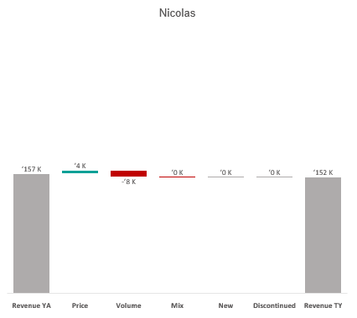
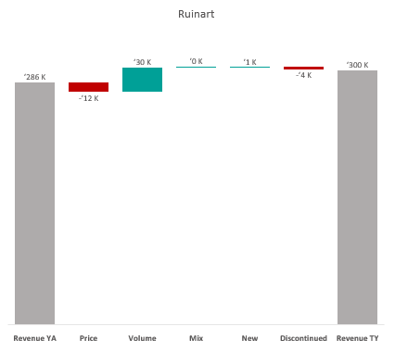
Revenue by Price vs. Volume vs. Mix analysis (Replace with So What)
Revenue by Price vs. Volume vs. Mix analysis | Nicolas vs. Ruinart | Champagnes | NICOLAS EST | P12M
DATA SOURCE: Trade Panel/Retailer Data | Ending June 2025

